Slide 1

ONLINE RETAIL DATASET PRESENTATION
This Photo by Unknown Author is licensed under CC BY-NC-ND

Slide 2
INTRODUCTION
Hello sir, Thank you, For giving me this opportunity I am Dadaso Shivaji Patil and I am from Kolhapur.
I have Completed my bachelor degree in chemistry from Shivaji University Kolhapur. And I am right now pursuing PG Diploma in Data science & AI from SPPU That’s all about my self Now I will present what insights i got from this projects.

Slide 3
Here's a brief presentation plan outlining each question, the chart to use, and key points to identify:
Question 1: Revenue Trend Analysis for 2011 Chart: I will use Line Chart for this task Key Points: This visualization depicts the revenue trends throughout the year 2011, providing insights into seasonal variations. Time series analysis of revenue data for 2011. Monthly revenue breakdown to identify seasonal trends. Forecasting implications for the next year.

Slide 4
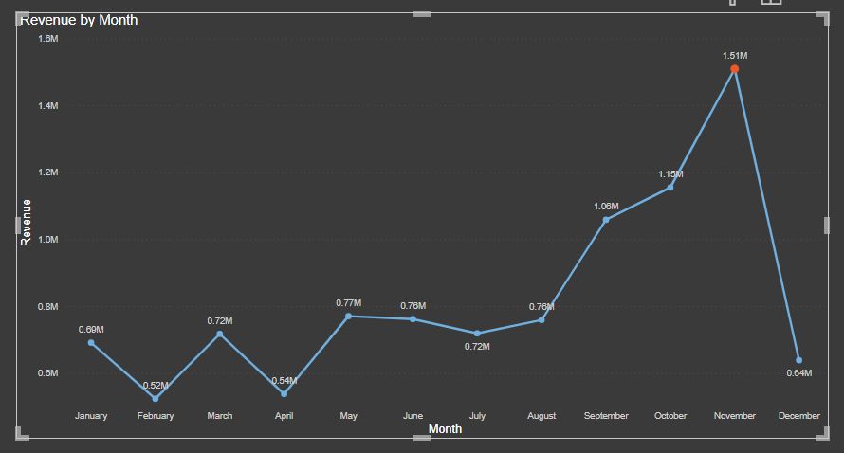

Slide 5
Question 2: Top 10 Revenue-Generating Countries (Excluding UK)
Chart: I will use Clustered Column chart for this task Key Points: This visualization highlights the top 10 countries generating the highest revenue, excluding the United Kingdom, and includes the quantity sold for each country. Top 10 countries generating the highest revenue, excluding the UK. Visual comparison of revenue and quantity sold. Insights into revenue distribution across countries.

Slide 6
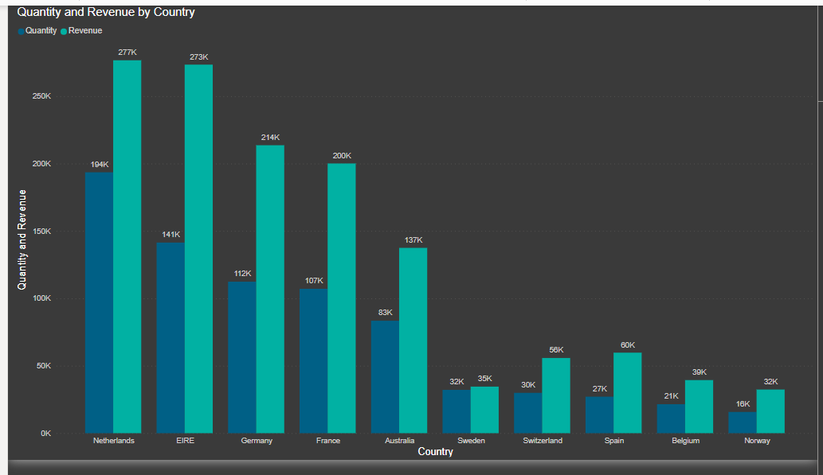

Slide 7
Question 3: Top 10 Customers by Revenue
Chart: I will use Vertical Bar Chart this task Key Points: This visualization showcases the top 10 customers ranked by revenue, assisting in identifying key revenue-generating customers. Identification of top 10 customers by revenue. Visualization of revenue distribution, highlighting top customers. Importance of targeting higher revenue-generating customers for satisfaction and retention.

Slide 8
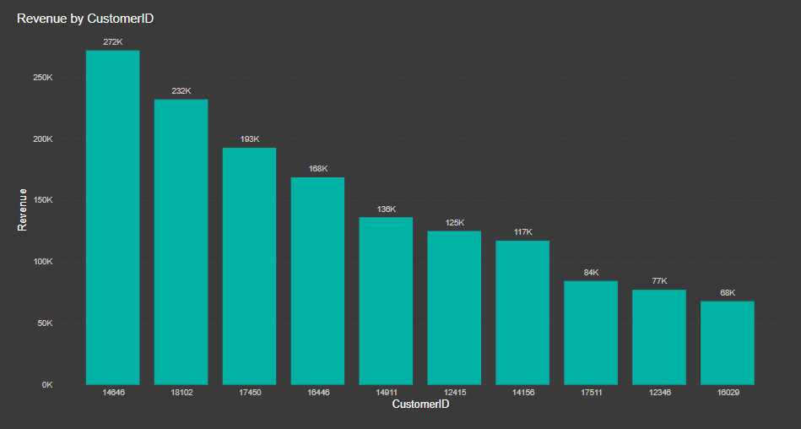

Slide 9
Question 4: Regional Demand Analysis Chart: I will use Shape Map for this task Key Points: This visualization presents the demand for products across different regions, aiding in identifying areas with high demand for potential expansion opportunities.

Slide 10
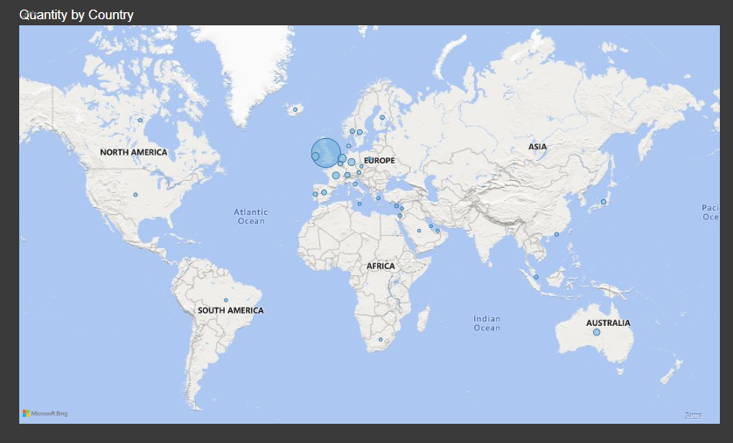
I hope you will Accept this my presentation Activity Thank you sir

